Slide 1
Gradient Descent

Slide 2
What is Gradient Descent or Steepest Descent?
Gradient descent was initially discovered by "Augustin-Louis Cauchy" in mid of 18th century.
Gradient Descent is defined as one of the most commonly used iterative optimization algorithms of machine learning to train the machine learning and deep learning models. It helps in finding the local minimum of a function.

Slide 3
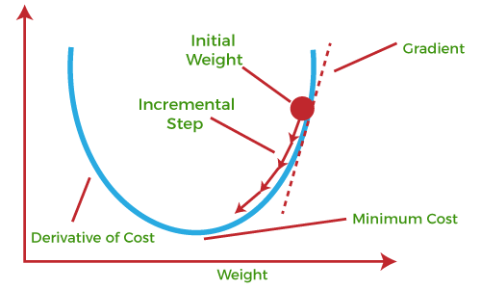
Gradient Descent

Slide 4
The best way to define the local minimum or local maximum of a function using gradient descent is as follows:
If we move towards a negative gradient or away from the gradient of the function at the current point, it will give the local minimum of that function.
Whenever we move towards a positive gradient or towards the gradient of the function at the current point, we will get the local maximum of that function.

Slide 5
The main objective of using a gradient descent algorithm is to minimize the cost function using iteration.
To achieve this goal, it performs two steps iteratively:
Calculates the first-order derivative of the function to compute the gradient or slope of that function.
Move away from the direction of the gradient, which means slope increased from the current point by alpha times, where Alpha is defined as Learning Rate. It is a tuning parameter in the optimization process which helps to decide the length of the steps.

Slide 6
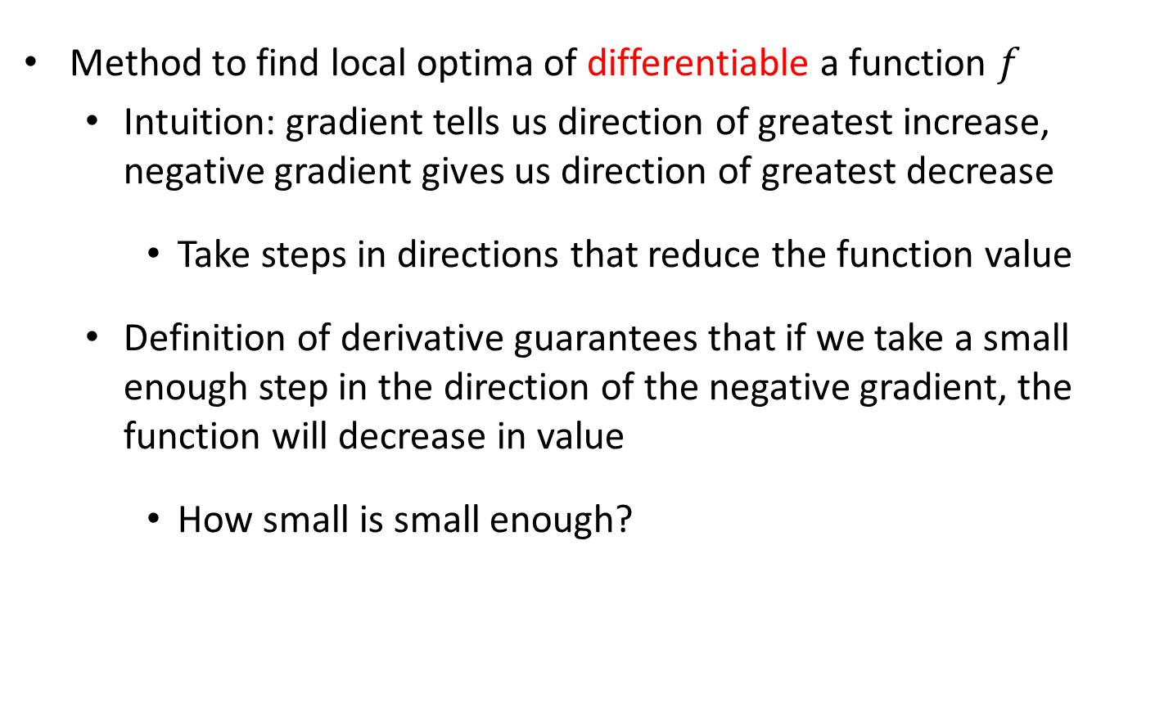
Gradient Descent
Method to find local optima of differentiable a function $f$
  Intuition: gradient tells us direction of greatest increase, negative gradient gives us direction of greatest decrease
    Take steps in directions that reduce the function value
  Definition of derivative guarantees that if we take a small enough step in the direction of the negative gradient, the function will decrease in value
    How small is small enough?

Slide 7
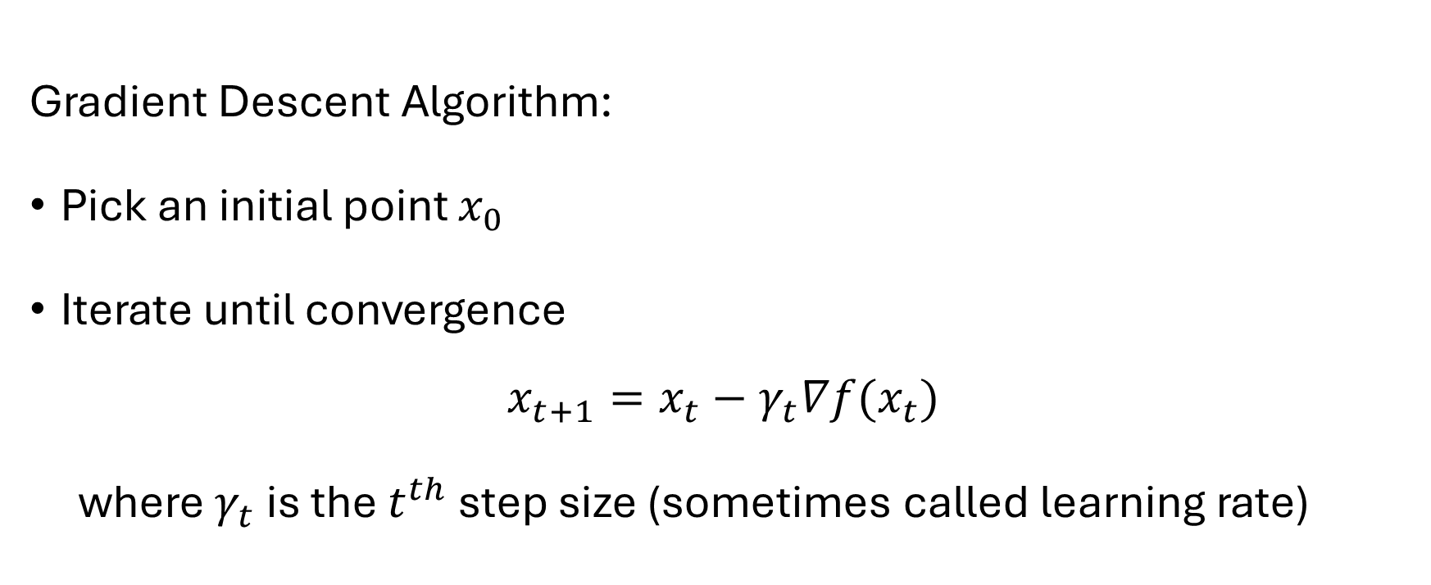
Gradient Descent
Gradient Descent Algorithm:
Pick an initial point $x_{0}$
Iterate until convergence
$$x_{t+1}=x_{t}−γ_{t}∇f(x_{t})$$
where $γ_{t}$ is the $t^{th}$ step size (sometimes called learning rate)
When do we stop?

Slide 8
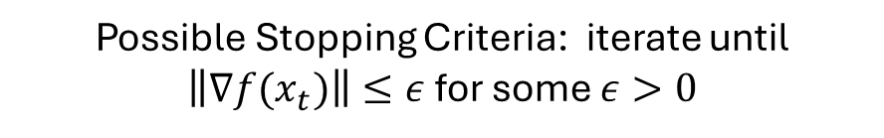
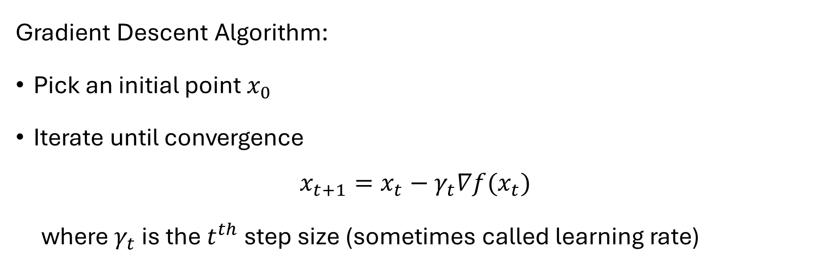

Gradient Descent
Gradient Descent Algorithm:
Pick an initial point $x_{0}$
Iterate until convergence
$$x_{t+1}=x_{t}−γ_{t}∇f(x_{t})$$
where $γ_{t}$ is the $t^{th}$ step size (sometimes called learning rate)
Possible Stopping Criteria: iterate until $\left\|∇f(x_{t})\right\|≤ε$ for some $ε>0$
How small should $ε$ be?

Slide 9
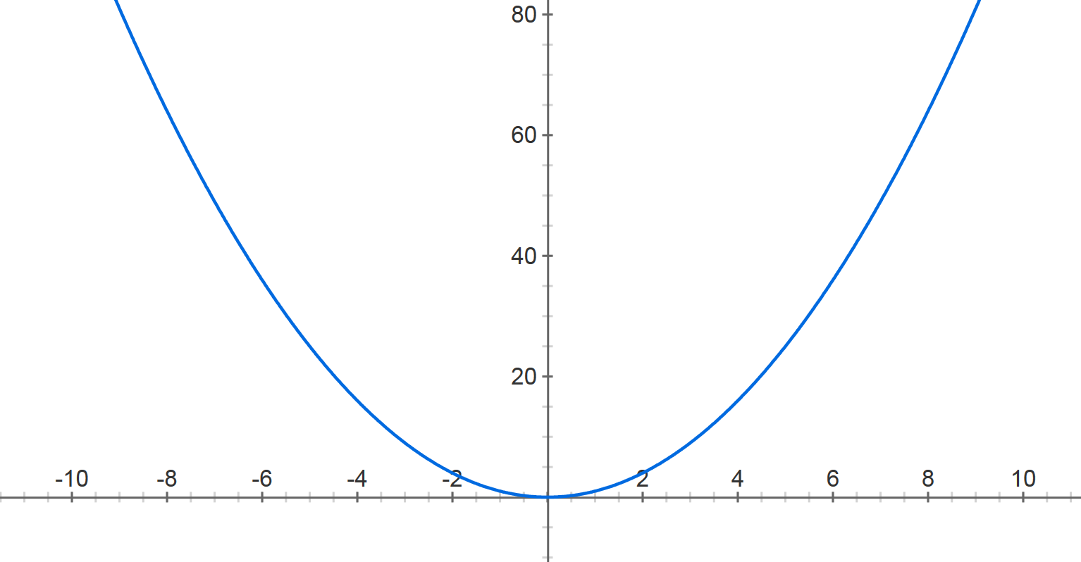



Gradient Descent
$$f\left(x\right)=x^{2}$$
Step size: $.8$
$$x^{(0)}=−4$$

Slide 10



Gradient Descent
$$f\left(x\right)=x^{2}$$
Step size: $.8$
$$x^{(0)}=−4$$
$$x^{(1)}=2.4$$

Slide 11




Gradient Descent
$$f\left(x\right)=x^{2}$$
Step size: $.8$
$$x^{(0)}=−4$$
$$x^{(1)}=2.4$$
$$x^{(2)}=2.4− .8⋅2⋅2.4$$
$$x^{(1)}=0.4$$

Slide 12


Gradient Descent
$$f\left(x\right)=x^{2}$$
Step size: $.8$
$$x^{(0)}=−4$$
$$x^{(1)}=2.4$$
$$x^{(2)}=−1.44$$

Slide 13






Gradient Descent
$$f\left(x\right)=x^{2}$$
Step size: $.8$
$$x^{(0)}=−4$$
$$x^{(1)}=2.4$$
$x^{(2)}=−$1.44
$$x^{(3)}=.864$$
$$x^{(4)}=−0.5184$$
$$x^{(5)}=0.31104$$
$$x^{(30)}=−8.84296e−07$$

Slide 14
The starting point is used to evaluate the performance as it is considered just as an arbitrary point.
At this starting point, we will derive the first derivative or slope and then use a tangent line to calculate the steepness of this slope. Further, this slope will inform the updates to the parameters (weights and bias).
The slope becomes steeper at the starting point or arbitrary point, but whenever new parameters are generated, then steepness gradually reduces, and at the lowest point, it approaches the lowest point, which is called a point of convergence.

Slide 15
The main objective of gradient descent is to minimize the cost function or the error between expected and actual.
To minimize the cost function, two data points are required:
  Direction & Learning Rate
These two factors are used to determine the partial derivative calculation of future iteration and allow it to the point of convergence or local minimum or global minimum.

Slide 16
Learning Rate
It is defined as the step size taken to reach the minimum or lowest point.
This is typically a small value that is evaluated and updated based on the behavior of the cost function.
If the learning rate is high, it results in larger steps but also leads to risks of overshooting the minimum.
At the same time, a low learning rate shows the small step sizes, which compromises overall efficiency but gives the advantage of more precision.

Slide 17
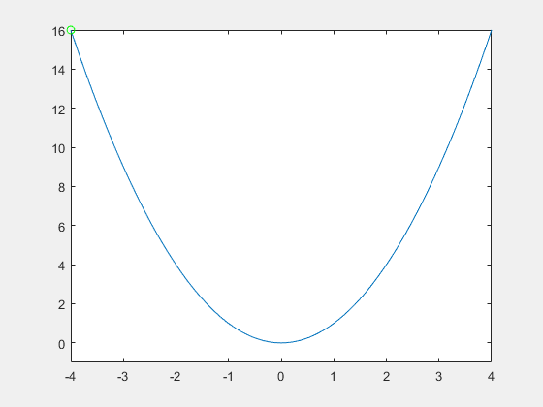
Large Learning rate
Step size: .9

Slide 18

Smaller learning rate
Step size: .2

Slide 19
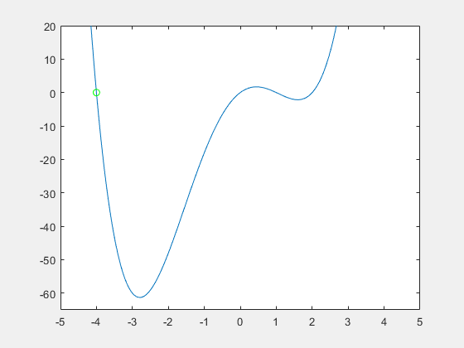
Gradient Descent
Step size matters!

Slide 20
Gradient Descent
Step size matters!

Slide 21
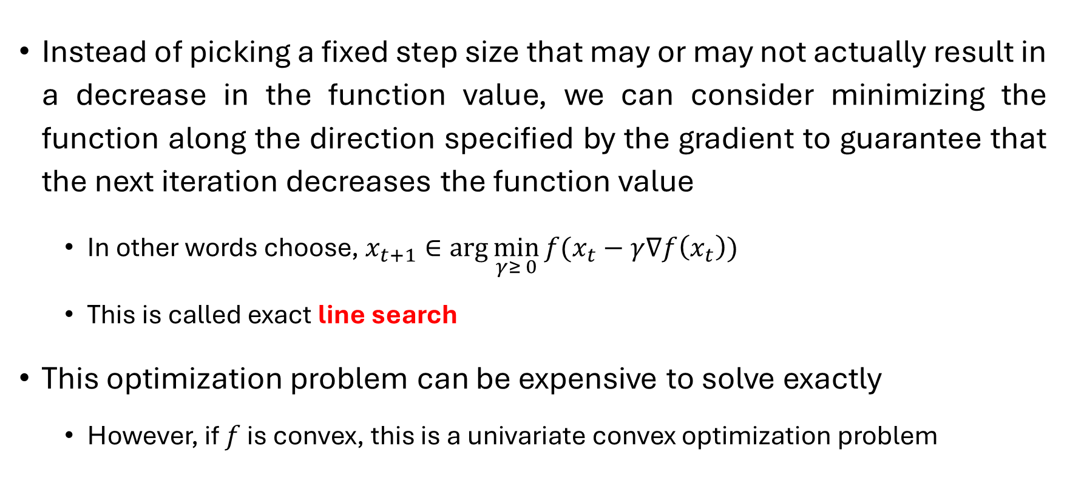
Line Search
Instead of picking a fixed step size that may or may not actually result in a decrease in the function value, we can consider minimizing the function along the direction specified by the gradient to guarantee that the next iteration decreases the function value
  In other words choose, $x_{t+1}∈\arg{\min_{γ≥ 0}{f(x_{t}−γ∇f\left(x_{t}\right))}}$
  This is called exact line search
This optimization problem can be expensive to solve exactly
  However, if $f$ is convex, this is a univariate convex optimization problem

Slide 22
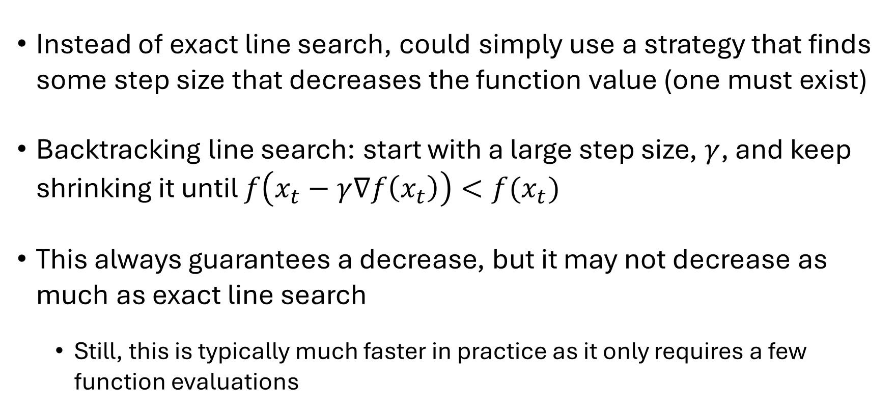
Backtracking Line Search
Instead of exact line search, could simply use a strategy that finds some step size that decreases the function value (one must exist)
Backtracking line search: start with a large step size, $γ$, and keep shrinking it until $f\left(x_{t}−γ∇f\left(x_{t}\right)\right)<f(x_{t})$
This always guarantees a decrease, but it may not decrease as much as exact line search
  Still, this is typically much faster in practice as it only requires a few function evaluations

Slide 23
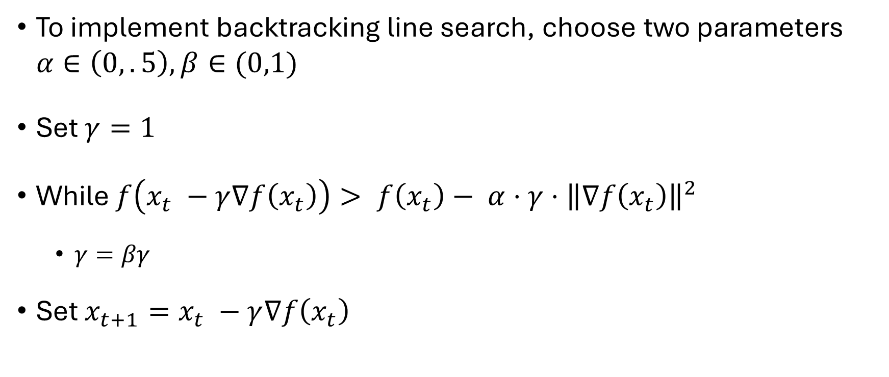
Backtracking Line Search
To implement backtracking line search, choose two parameters $α∈\left(0,.5\right), β∈(0,1)$
Set $γ=1$
While $f\left(x_{t} −γ∇f\left(x_{t}\right)\right)> f\left(x_{t}\right)− α⋅γ⋅{\left\|∇f\left(x_{t}\right)\right\|}^{2}$
  $γ=βγ$
Set $x_{t+1}=x_{t} −γ∇f\left(x_{t}\right)$
Iterations continue until a step size is found that decreases the function “enough”

Slide 24
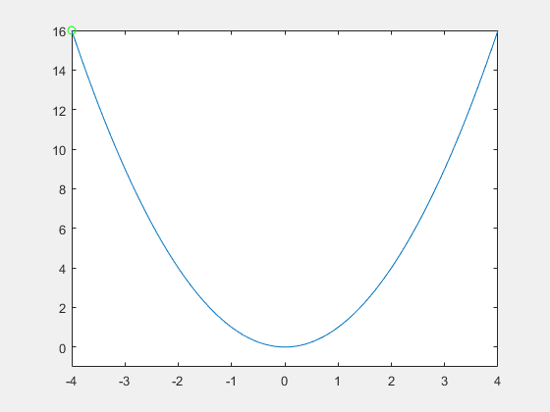

Backtracking Line Search
$$α=.2, β=.99$$

Slide 25

Backtracking Line Search
$$α=.1, β=.3$$

Slide 26
Cost Functions
Learning Conditional Distributions with Maximum Likelihood
An important aspect of the design of a deep neural network is the choice of the cost function.
The cost functions for neural networks are more or less the same as those for other parametric models, such as linear models.
In most cases, the parametric model defines a distribution p(y | x;θ ) and we use the principle of maximum likelihood.
This means we use the cross-entropy between the training data and the model’s predictions as the cost function.
Mean squared error and mean absolute error often lead to poor results when used with gradient-based optimization.

Slide 27

This cost function is given by
The specific form of the cost function changes from model to model, depending on the specific form of log p_{model}.
The expansion of the above equation typically yields some terms that do not depend on the model parameters and may be discarded.
An advantage of this approach of deriving the cost function from maximum likelihood is that it removes the burden of designing cost functions for each model.
Specifying a model p(y | x) automatically determines a cost function log p(y | x).

Slide 28
One unusual property of the cross-entropy cost used to perform maximum likelihood estimation is that it usually does not have a minimum value when applied to the models commonly used in practice.
For discrete output variables, most models are parametrized in such a way that they cannot represent a probability of zero or one, but can come arbitrarily close to doing so.
Logistic regression is an example of such a model.
For real-valued output variables, if the model can control the density of the output distribution (for example, by learning the variance parameter of a Gaussian output distribution) then it becomes possible to assign extremely high density to the correct training set outputs, resulting in cross-entropy approaching negative infinity.

Slide 29
Output Units
The choice of cost function is tightly coupled with the choice of output unit.
Most of the time, we simply use the cross-entropy between the data distribution and the model distribution.
The choice of how to represent the output then determines the form of the cross-entropy function.
Suppose that the feedforward network provides a set of hidden features defined by h = f (x ;θ).
The role of the output layer is then to provide some additional transformation from the features to complete the task that the network must perform.

Slide 30
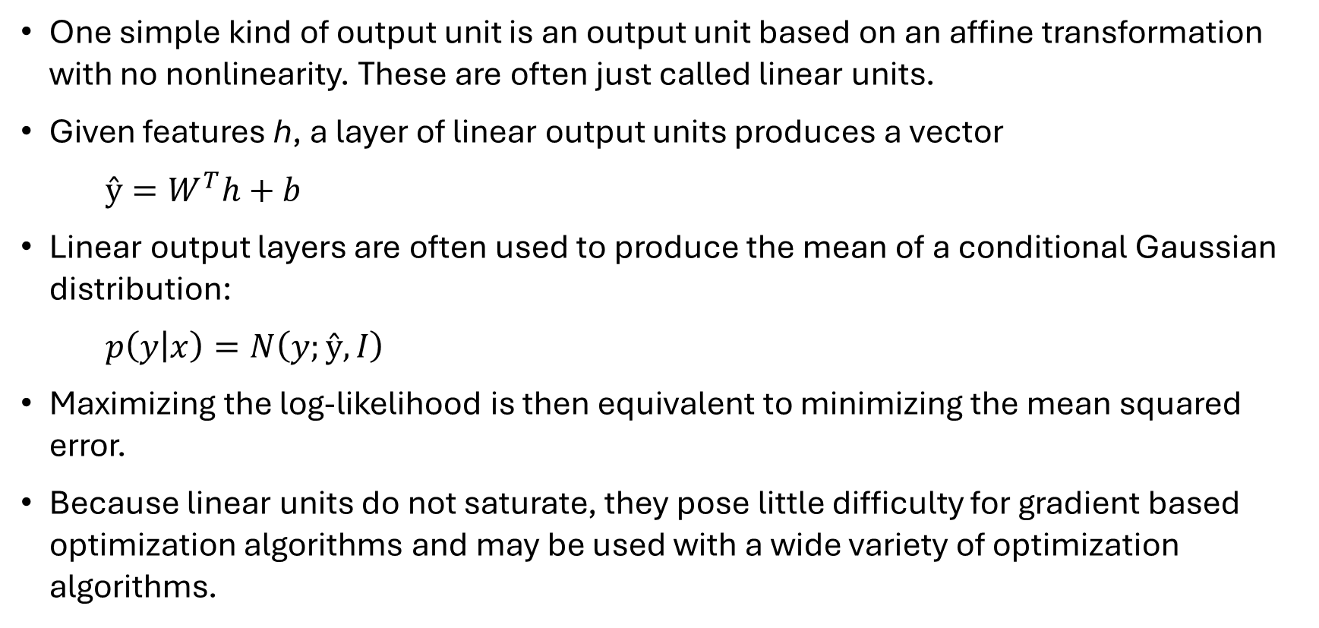
Linear Units for Gaussian Output Distributions
One simple kind of output unit is an output unit based on an affine transformation with no nonlinearity. These are often just called linear units.
Given features h, a layer of linear output units produces a vector
$ŷ=W^{T}h+b$
Linear output layers are often used to produce the mean of a conditional Gaussian distribution:
$p\left(y | x\right)=N\left(y;ŷ,I\right)$
Maximizing the log-likelihood is then equivalent to minimizing the mean squared error.
Because linear units do not saturate, they pose little difficulty for gradient based optimization algorithms and may be used with a wide variety of optimization algorithms.

Slide 31
Sigmoid Units for Bernoulli Output Distributions
Many tasks require predicting the value of a binary variable y . Classification problems with two classes can be cast in this form.
The maximum-likelihood approach is to define a Bernoulli distribution over y conditioned on x.
A Bernoulli distribution is defined by just a single number. The neural net needs to predict only P (y = 1 | x). For this number to be a valid probability, it must lie in the interval [0, 1].

Slide 32
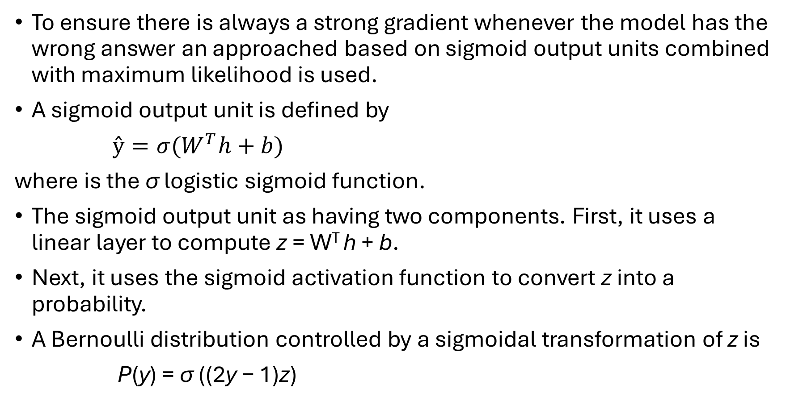
To ensure there is always a strong gradient whenever the model has the wrong answer an approached based on sigmoid output units combined with maximum likelihood is used.
A sigmoid output unit is defined by
$ŷ={σ(W}^{T}h+b)$
where is the σ logistic sigmoid function.
The sigmoid output unit as having two components. First, it uses a linear layer to compute z = W^{T} h + b.
Next, it uses the sigmoid activation function to convert z into a probability.
A Bernoulli distribution controlled by a sigmoidal transformation of z is
P(y) = σ ((2y − 1)z)

Slide 33
Softmax Units for Multinoulli Output Distributions
Any time we wish to represent a probability distribution over a discrete variable with n possible values, we may use the softmax function.
This can be seen as a generalization of the sigmoid function which was used to represent a probability distribution over a binary variable.
Softmax functions are most often used as the output of a classifier, to represent the probability distribution over n different classes.

Slide 34
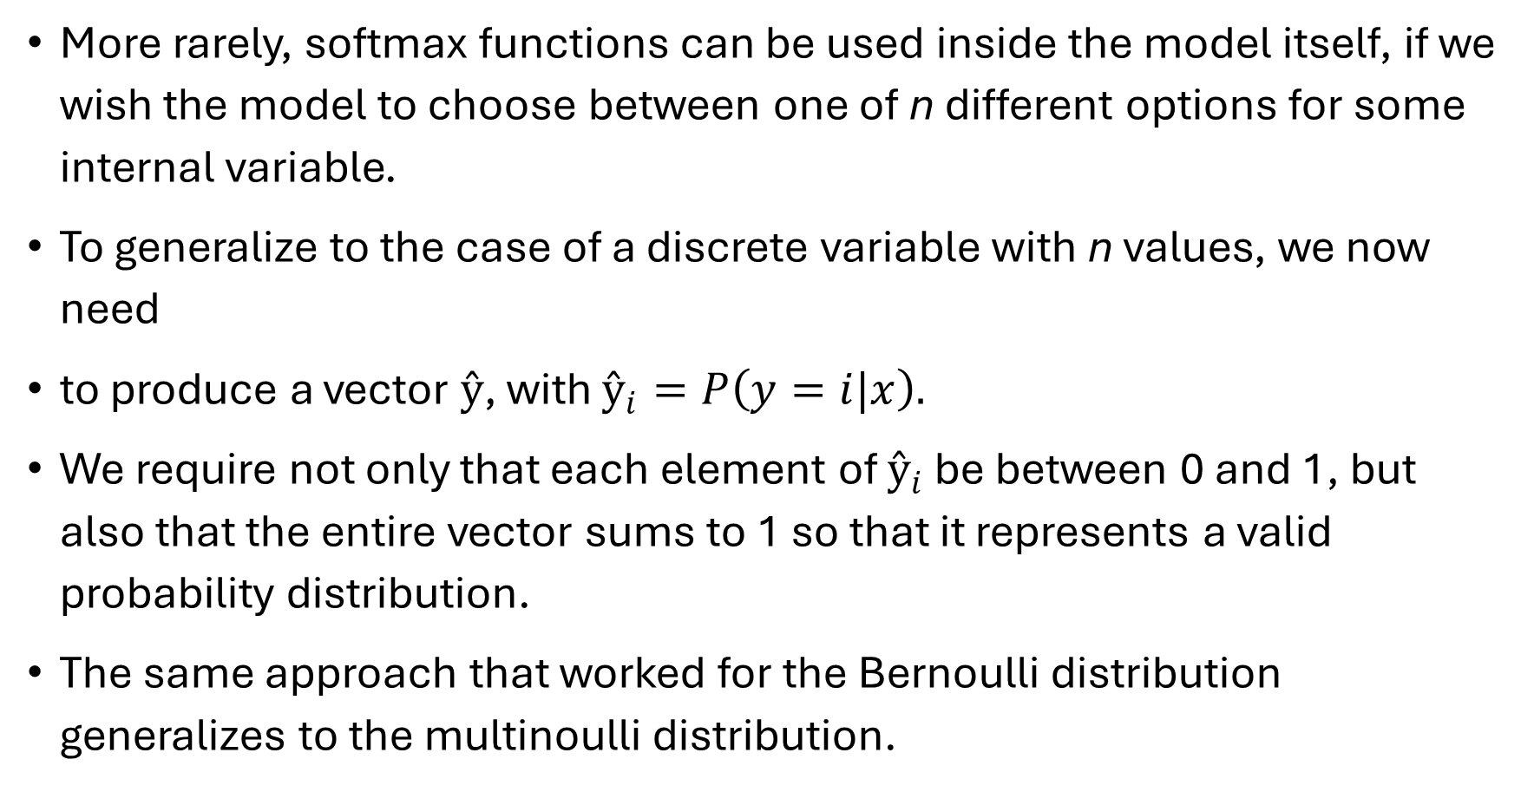
More rarely, softmax functions can be used inside the model itself, if we wish the model to choose between one of n different options for some internal variable.
To generalize to the case of a discrete variable with n values, we now need
to produce a vector $ŷ$, with $ŷ_{i}=P\left(y=i|x\right).$
We require not only that each element of $ŷ_{i}$ be between 0 and 1, but also that the entire vector sums to 1 so that it represents a valid probability distribution.
The same approach that worked for the Bernoulli distribution generalizes to the multinoulli distribution.

Slide 35
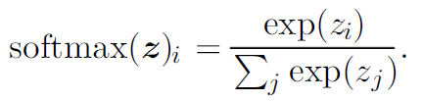

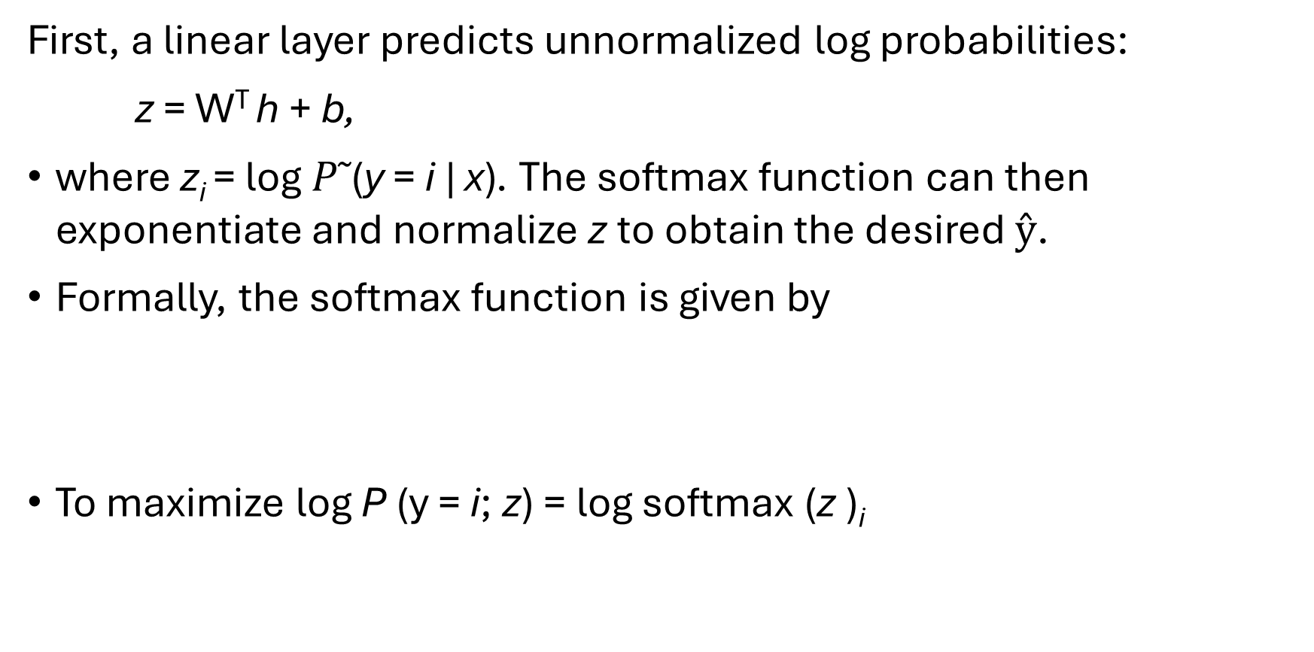
First, a linear layer predicts unnormalized log probabilities:
z = W^{T} h + b,
where z_{i} = log $P˜$(y = i | x). The softmax function can then exponentiate and normalize z to obtain the desired $ŷ$.
Formally, the softmax function is given by
To maximize log P (y = i; z) = log softmax (z )_{i}

